Slide 2
Absence of Copyright
This slideshow contains photos, diagrams, and information, some of which were attained through internet searches of public websites. The author of this presentation does not own the copyright on this information, so this slideshow is for personal use only—not for sale or profit. Please utilize it to seek the Lord and grow in your knowledge of His Word and ways.
Bro Stan’s Revelation Study is available on our church website:
www.faithprinceton.org

Slide 4
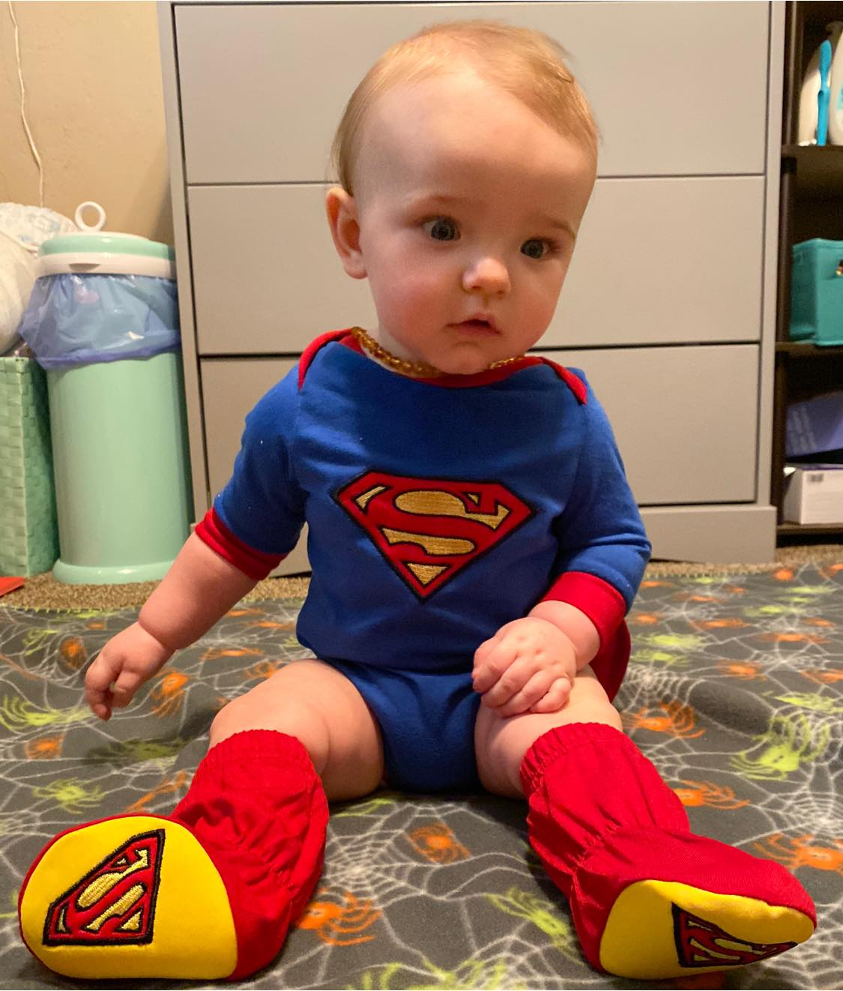
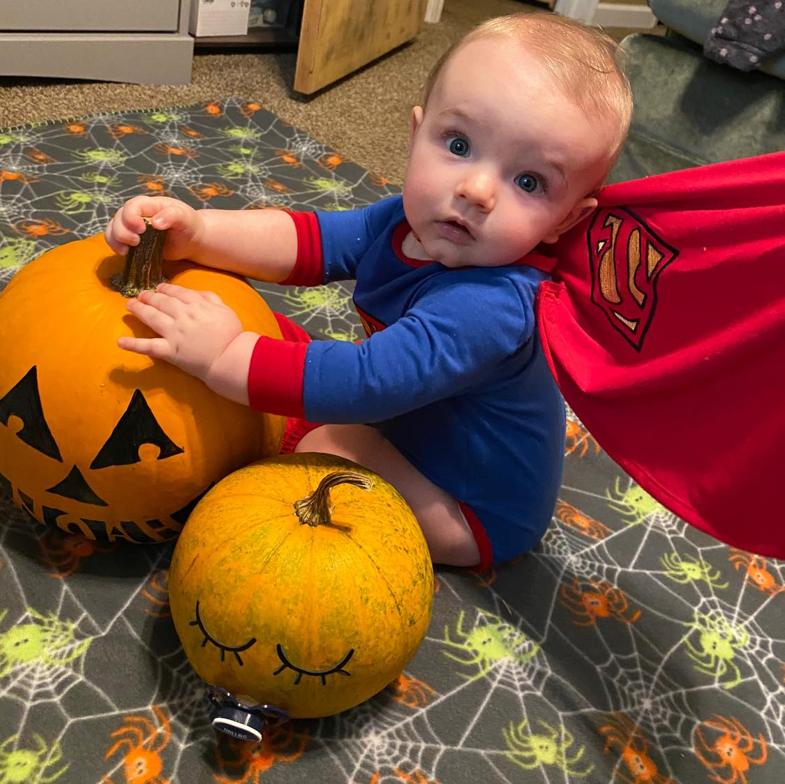
Super Noah...

Slide 5
Prayer and Announcements
Sunday:
9:15 Small Group Sunday School Classes
(Kids class and nursery as well)
10:30 Worship
-----------------------------------------------
Presidential Election!

Slide 7
BEGIN HERE NOVEMBER 4, 2020
LAST WEEK 23 Revelation 15
The End of Wrath
THIS WEEK 24 Revelation 16
Armageddon

Slide 8
Revelation 16:12-16 The Sixth Bowl of Wrath
12 The sixth angel poured out his bowl on the great river, the Euphrates; and its water was dried up, so that the way would be prepared for the kings from the east.
13 And I saw coming out of the mouth of the dragon and out of the mouth of the beast and out of the mouth of the false prophet, three unclean spirits like frogs; 14 for they are spirits of demons, performing signs, which go out to the kings of the whole world, to gather them together for the war of the great day of God, the Almighty..
Notes:
12 sixth : Euphrates... dried up
so that the way would be prepared for the kings from the east.
Three unclean spirits like frogs?
From mouth of the dragon, beast, and false prophet = from mouth ➔ involves lies and deception?
King James Bible 14 For they are the spirits of devils, working miracles, which go forth unto the kings of the earth and of the whole world, to gather them to the battle of that great day of God Almighty.
Spirits of demons ➔ demons need hosts? Can indwell non-believers.... Can influence and oppress believers! ➔ NEED for casting out, cleansing
Performing signs ➔ Satan can produce miraculous things... Has much power and influence in worldly realm
Gathering the kings of the whole world together ➔ Why would they join forces with Satan??? Blamed God for the wrath and chaos of the bowl judments!!! Would not repent of their evil deeds!!!
For the War of the great day of God (vs 16 Har-Magedon) ➔ the Lord’s Day... Judgment Day... Day of Reckoning... Final Day of Judgment... Lots of names and references to the final day of judgment... It is sure!

Slide 9
Revelation 16:13-16 Preparing for Armageddon
15 (“Behold, I am coming like a thief. Blessed is the one who stays awake and keeps his clothes, so that he will not walk about naked and men will not see his shame.”)
16 And they gathered them together to the place which in Hebrew is called Har-Magedon.
Notes:
INTERLUDE: OR PARENTHETICAL STATEMENT: I AM coming
Like a thief ➔
Matthew 24:43 But understand this: If the homeowner had known in which watch of the night the thief was coming, he would have kept watch and would not have let his house be broken into. Luke 12:37-39 37 Blessed are those servants whom the master finds on watch when he returns. Truly I tell you, he will dress himself to serve and will have them recline at the table, and he himself will come and wait on them. 38 Even if he comes in the second or third watch of the night and finds them alert, those servants will be blessed. 39 But understand this: If the homeowner had known at what hour the thief was coming, he would not have let his house be broken into. 1 Thessalonians 5:2 2 For you are fully aware that the day of the Lord will come like a thief in the night. 3 While people are saying, “Peace and security,” destruction will come upon them suddenly, like labor pains on a pregnant woman, and they will not escape. 4 But you, brothers, are not in the darkness so that this day should overtake you like a thief. 2 Peter 3:10 But the day of the Lord will come like a thief. The heavens will disappear with a roar, the elements will be destroyed by fire, and the earth and its works will be laid bare. Revelation 3:3 Remember, then, what you have received and heard. Keep it and repent. If you do not wake up, I will come like a thief, and you will not know the hour when I will come upon you. Revelation 3:11 I am coming soon. Hold fast to what you have, so that no one will take your crown. Revelation 3:18 I counsel you to buy from Me gold refined by fire so that you may become rich, white garments so that you may be clothed and your shameful nakedness not exposed, and salve to anoint your eyes so that you may see. Revelation 22:7 "Behold, I am coming quickly. Blessed is the one who keeps the words of prophecy in this book."
STAY AWAKE
STAY DRESSED: literally “watching and keeping the garments” (present active participles)
grēgoreúō – literally, "stay awake"; (figuratively) be vigilant (responsible, watchful). to watch i. e. give strict attention to, be cautious, active
tēréō (from tēros, "a guard") – properly, maintain (preserve); (figuratively) spiritually guard (watch), keep intact. ; to attend to carefully, take care of
himátion – a cloak; the outer garment worn over the 5509/xitōn ("the under-garment worn next to the skin").
[2440 /himátion ("a robe") was often made of wool with openings for the head and arms, and worn loosely over the 5509/xitōn ("the under-tunic").]
Har-Magedon = “Hill of Megiddo” --- site of defeat of Josiah by pharaoh Neco; also, many OT battles: --- Judges 5; 2 Kings 6:17, 23; Zech 12:11
Napoleon fought here... As did WW1 battles
14 x 20 miles in size

Slide 10
Revelation 16:15 Be ready
15 (“Behold, I am coming like a thief. Blessed is the one who stays awake and keeps his clothes, so that he will not walk about naked and men will not see his shame.”)
Notes:
INTERLUDE: OR PARENTHETICAL STATEMENT: I AM coming
STAY AWAKE:
STAY DRESSED:
literally “watching and keeping the garments” (present active participles)
grēgoreúō – literally, "stay awake"; (figuratively) be vigilant (responsible, watchful). to watch i. e. give strict attention to, be cautious, active
tēréō (from tēros, "a guard") – properly, maintain (preserve); (figuratively) spiritually guard (watch), keep intact. ; to attend to carefully, take care of
himátion – a cloak; the outer garment worn over the 5509/xitōn ("the under-garment worn next to the skin").
[2440 /himátion ("a robe") was often made of wool with openings for the head and arms, and worn loosely over the 5509/xitōn ("the under-tunic").]
Jesus commanded His followers to “BE READY!” (Matthew 24)

Slide 11
Revelation 16:16 Armageddon
16 And they gathered them together to the place which in Hebrew is called Har-Magedon.
Notes:
Har-Magedon = “Hill of Megiddo” --- site of defeat of Josiah by pharaoh Neco; also, many OT battles: --- Judges 5; 2 Kings 6:17, 23; Zech 12:11
Napoleon fought here... As did WW1 battles
14 x 20 miles in size
Megiddo mentioned 12 times in Old Testament... But not as a battleground (10 times as a city, 2 as a plain)
ONLY HERE in the New Testament !!!

Slide 12
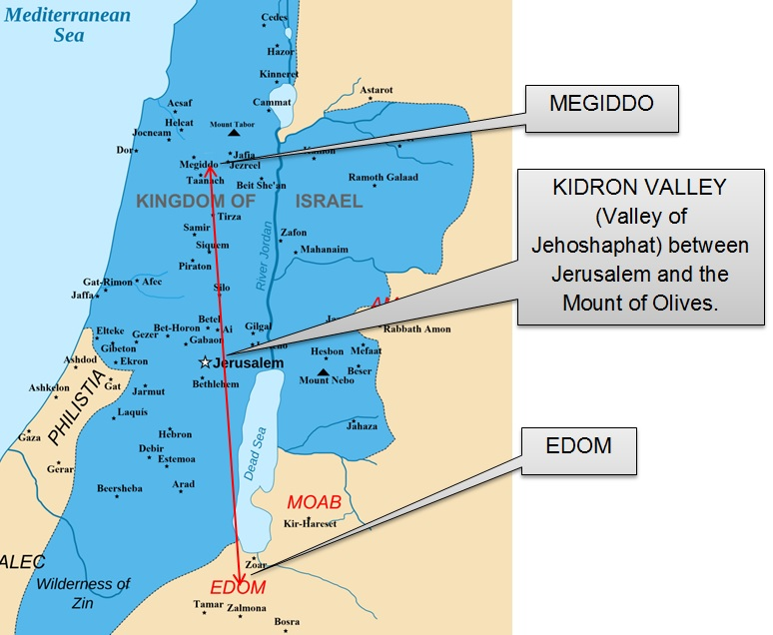
Location of Armageddon
Notes:
Har-Magedon = “Hill of Megiddo”
Interesting... Muslims have a similar thought of a final battle worse than all others... Wickipedia...
The Malhama Al-Kubra is detailed in multiple hadith narrations with varying details. However the basic narrative framework of the cycle of prophecies is as follows. According to Islamic eschatology, this Great Battle will occur after the Muslims and Christian Romans victoriously fight alongside each other against a common enemy.^{[4][5]} Following the victory a conflict will break out after a Roman claims that the cross brought them victory, and a Muslim in response claims that Allah brought them victory, and proceeds to destroy the cross, which leads to further reprisals.^{[6]} ^{[7]} ^{[5]} The Malhama Al-Kubra then ensues, followed by the conquest of Constantinople by the Muslims, then the coming of the Dajjal, followed by the descent from heaven and Second Coming of Jesus Christ('Isa).^{[4]} ^{[8]} Jesus will then kill the Dajjal, kill the swine, abolish the jizya tax and destroy the cross. He will follow the religion of the Prophet Muhammad and will pray behind al-Mahdi.

Slide 13
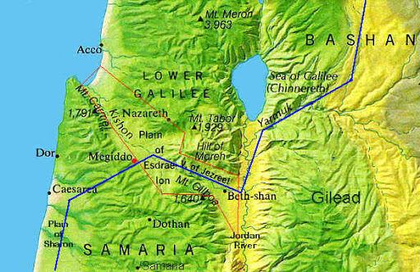
Notes:
Topographical map of Israel

Slide 14
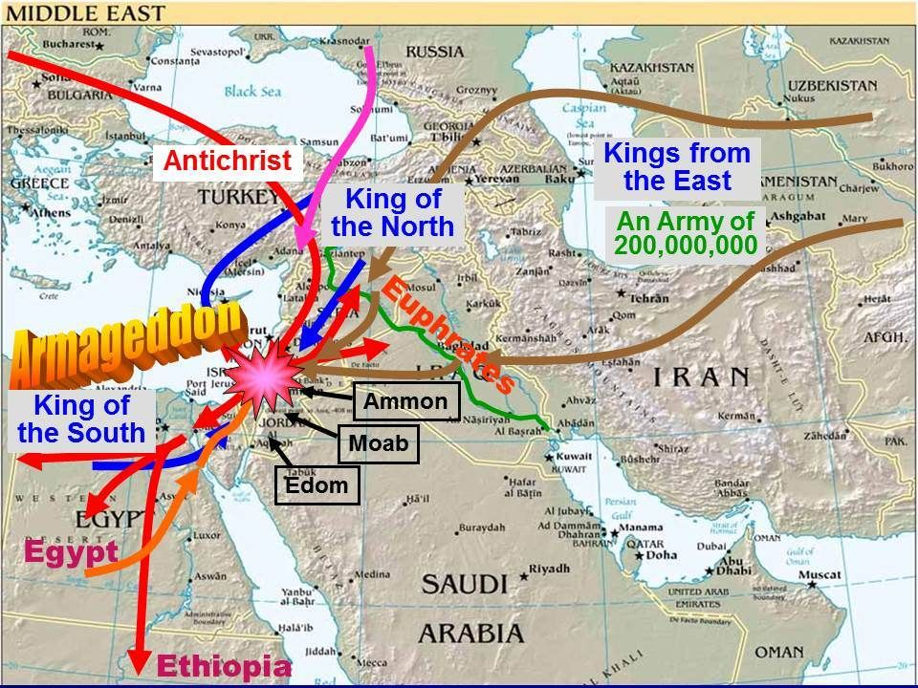

Slide 15
Revelation 16:17-21 Seventh Bowl of Wrath
17 Then the seventh angel poured out his bowl upon the air, and a loud voice came out of the temple from the throne, saying, “It is done.” 18 And there were flashes of lightning and sounds and peals of thunder; and there was a great earthquake, such as there had not been since man came to be upon the earth, so great an earthquake was it, and so mighty. 19 The great city was split into three parts, and the cities of the nations fell. Babylon the great was remembered before God, to give her the cup of the wine of His fierce wrath.
Notes:
Seventh: upon the air
IT IS DONE!
Lightning, Thunder, Earthquake: such as there had not been since man came to be upon the earth [Magnitude: Greatest Ever!]
Great City ➔ Babylon (rebuilt Babylon? Rome? World business and religious center!)
➔ split in three parts ➔ received the cup of the wine of His fierce wrath
And the cities of the nations fell
Babylon the great was remembered before God, to give her the cup of the wine of His fierce wrath.

Slide 16
Revelation 16:17-21 Seventh Bowl of Wrath
20 And every island fled away, and the mountains were not found. 21 And huge hailstones, about one hundred pounds each, came down from heaven upon men; and men blasphemed God because of the plague of the hail, because its plague was extremely severe.
Notes:
One hundred pound hailstones!!!
Men blasphemed ➔ NO REPENTANCE! NO REMORSE! Just anger and foul language and hearts!

Slide 17
Great Hailstone Stats
Matthew Kneisler, who has a background in aeronautical engineering estimated the size of the great hailstones that will fall and their velocity when they reach sea level. Kneisler used a hailstone that measured 5.581 inches in diameter and weighed 1.68 lbs (the largest ever to fall in the U.S. at the time of his work) to estimate the size of the great hailstones of Revelation 16:21.
A 100 lbs hailstone is around 29.8 inches in diameter. (The hailstones’ diameter would be larger than the diameter of an average mountain bike wheel.)
The hailstone would arrive at sea level traveling 284 miles per hour.
Notes:
Https://www.prophecyproof.org/largest-hailstones-ever/
Great Hailstone Stats
Matthew Kneisler, who has a background in aeronautical engineering, estimated the size of the great hailstones that will fall and their velocity when they reach sea level.
Kneisler used a hailstone that measured 5.581 inches in diameter and weighed 1.68 lbs (the largest ever to fall in the U.S. at the time of his work) to estimate the size of the great hailstones of Revelation 16:21.
A 100 lbs hailstone is around 29.8 inches in diameter.
The hailstone would arrive at sea level traveling 284 miles per hour.
The hailstones’ diameter would be larger than the diameter of an average mountain bike wheel.
The photo below shows a 29-inch (left) and a 26-inch (right) mountain bike wheel.

Slide 18
Summary of the Wrath in Revelation

Slide 20
Notes:
Vern Poythress and William Hendriksen outline of Revelation chart

Slide 21
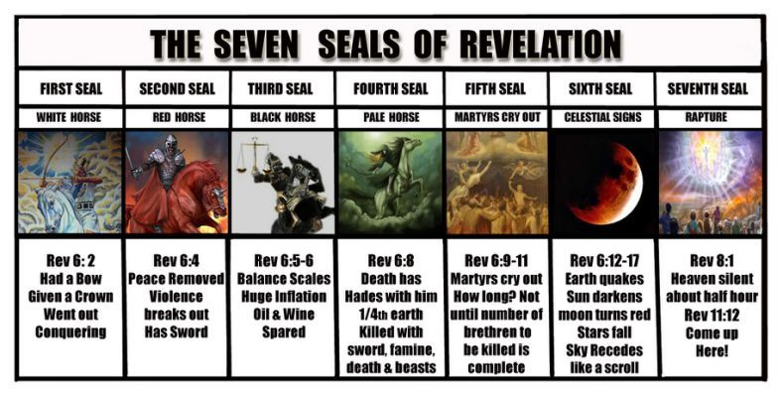

Slide 22
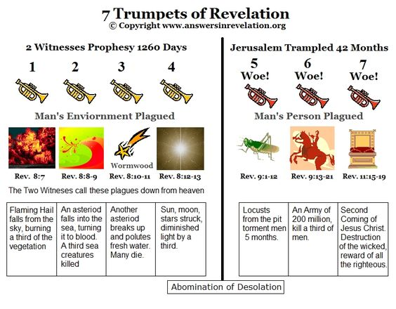

Slide 23
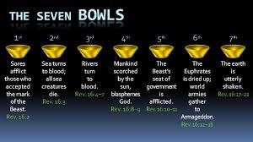

Slide 24
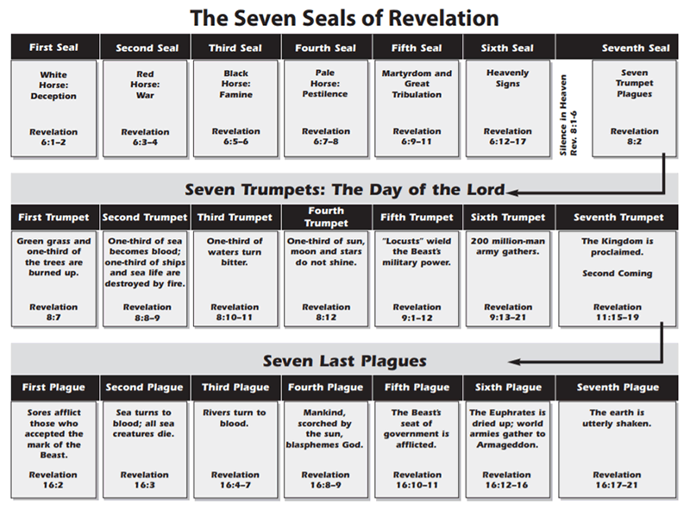
Notes:
The Seven Seals, Trumpets, and Bowls (Plagues)

Slide 25
END HERE November 4, 2020

